Slide 1

Exploring the Relationship Between the Pandemic and Traffic Collisions in Los Angeles
Charlie Bertelsen

Slide 2

Background
Stay at home orders and lockdowns led to a decrease in the need to leave the house and therefore a decrease in the total number of drivers on the road at any given time
Los Angeles is the second largest city in the U.S.
Notorious for bad traffic and drivers

Slide 3
Research Questions
Is there a correlation between the number of covid cases/deaths and the number of traffic collisions in Los Angeles California?
What is the relationship between these variables and what can we learn from it?

Slide 4
Data Description
LA County Covid Cases: https://catalog.data.gov/dataset/la-county-covid-cases
Contains information on the number of deaths, cases, new cases and new deaths for both the city of Los Angeles and the State of California.
2019-2023
LA Traffic Collision Data: https://catalog.data.gov/dataset/traffic-collision-data-from-2010-to-present
Traffic collision data including date, area, exact location, type of collision, and victim description.
2010-2023

Slide 5
Data Cleaning
Removing unnecessary columns
Sorting by date
Covert columns from string to date format
Checking for NULL values
Victim Age
Removing duplicate rows
Add total collisions column

Slide 6
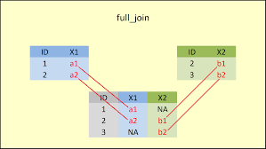
Data Joins
Full_join()
Rename date columns to match
Sort by date
Data for traffic collisions pre pandemic
New dataset with overlapping dates used for the majority of analysis

Slide 7
Exploratory Data Analysis
Visualizations
Univariate
Bivariate
High dimensional
Data Exploration Techniques
Outlier Detection
Multiple Linear Regression
Kmeans Clustering

Slide 8
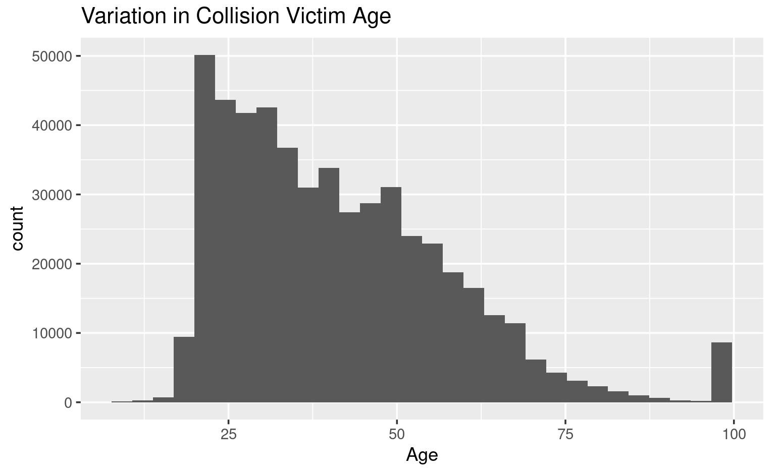
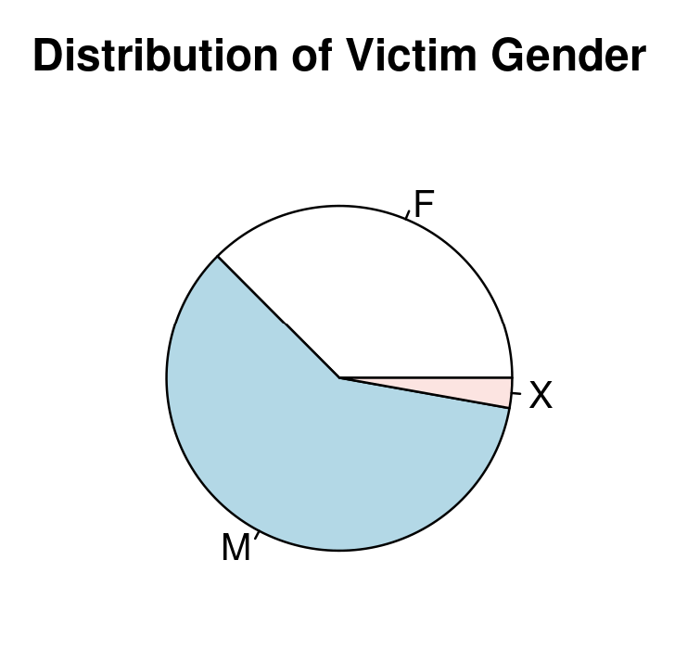
EDA: Univariate Visualizations
Demographics of traffic collisions
Most at risk age group for traffic accidents is early 20s to early 30’s
Large jump in traffic collisions for those in their late 90’s
Men accounted for a significantly larger portion of traffic collisions

Slide 9
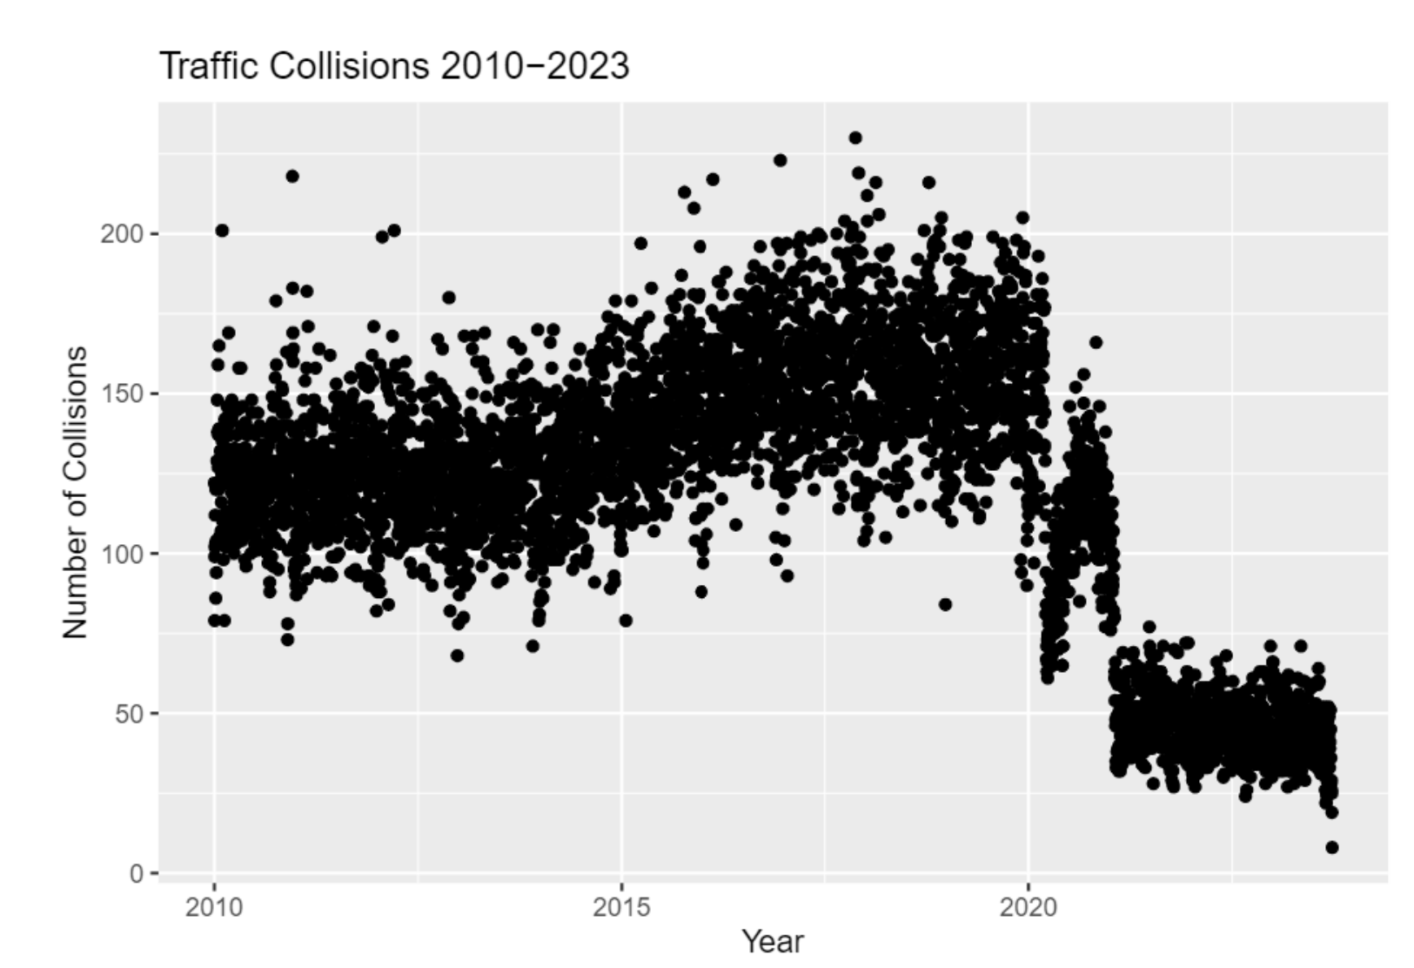
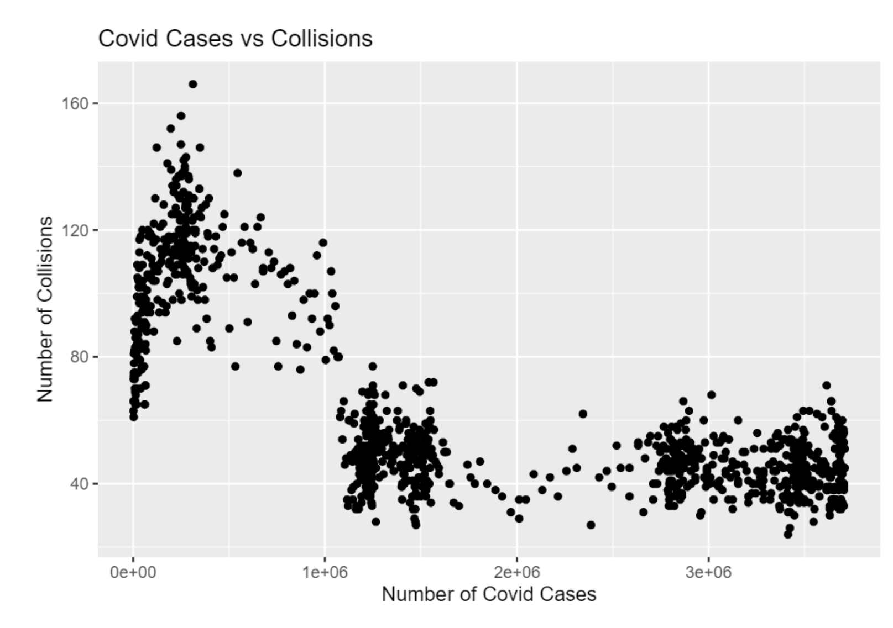
EDA: Bivariate Visualizations
Significant drop in traffic collisions around the year 2020
Traffic collisions were higher when the number of cases were lower and then decreased as the number of cases grew

Slide 10
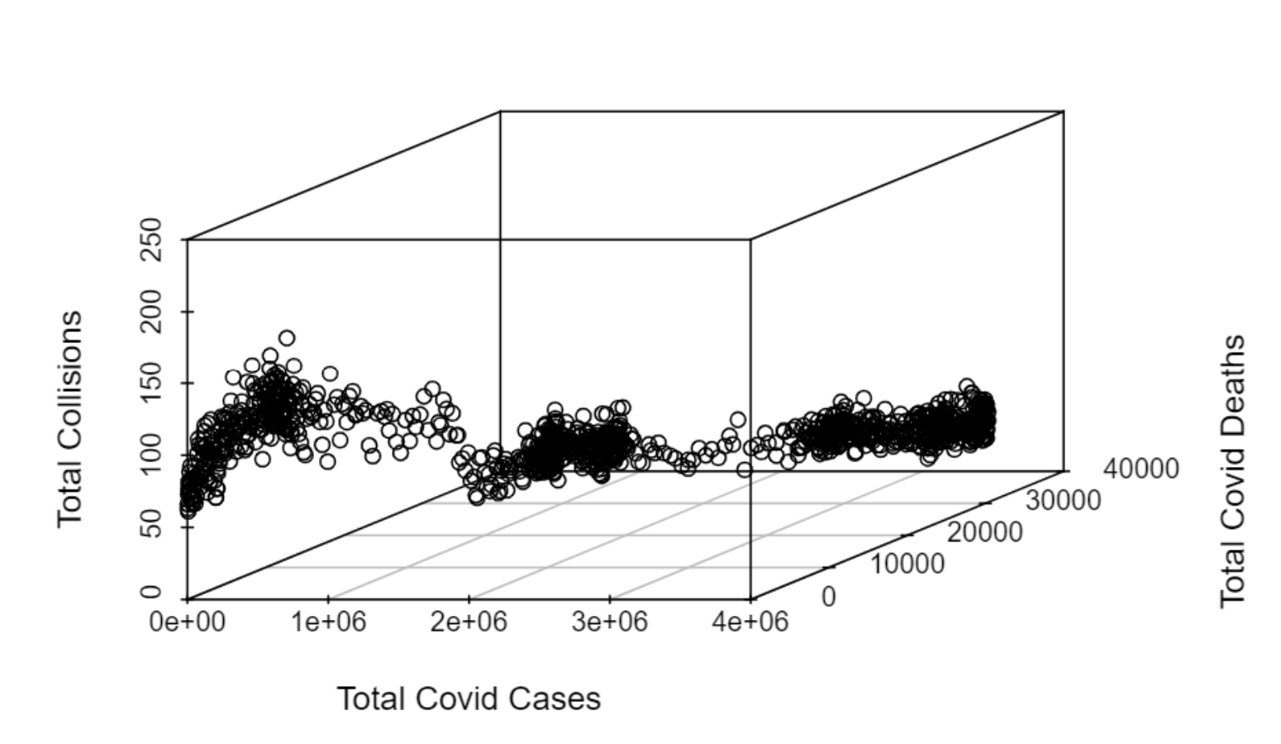
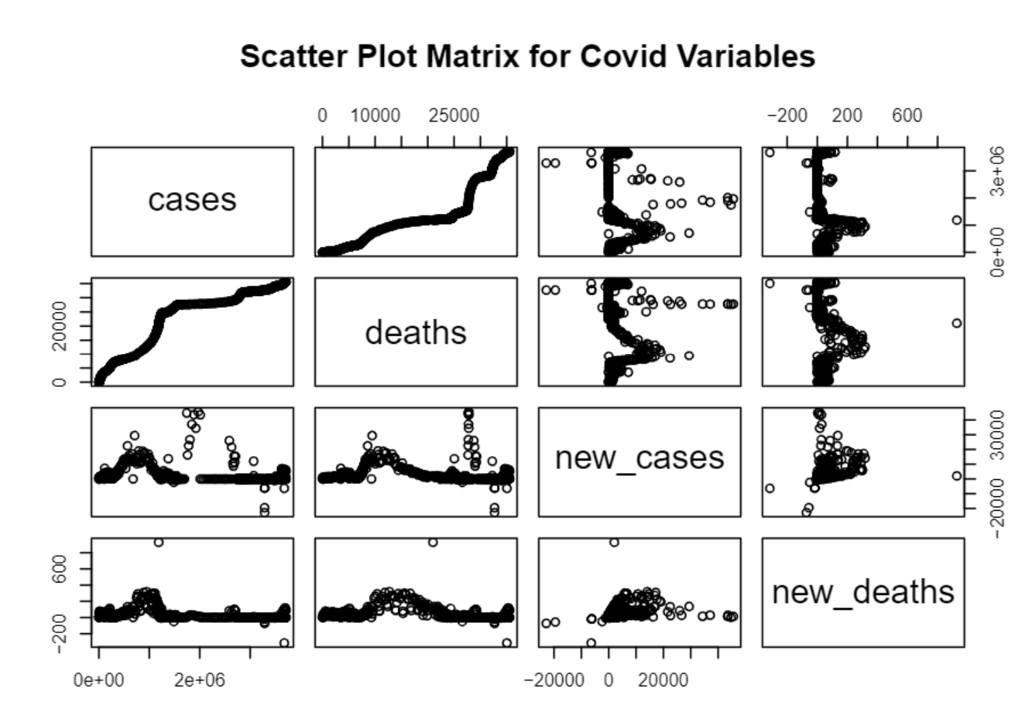
EDA: High-Dimensional Visualizations
Scatterplot matrix shows confirms strong relationship between cases and deaths and large spikes of new cases/deaths at some point during the pandemic
3d scatterplot shows decreasing traffic collisions as the number of cases and deaths increase

Slide 11
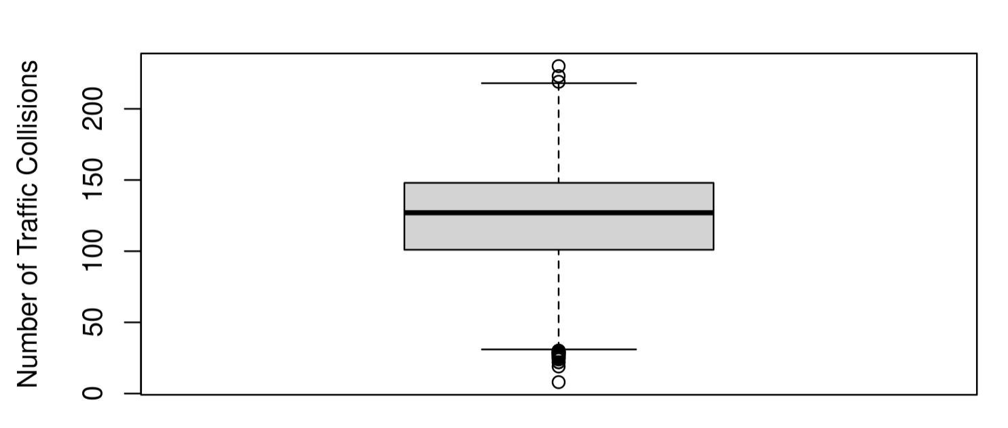
EDA techniques: Outlier Detection
Boxplot analysis showed that the only variable with potential outliers was traffic collisions
Created 2.5 and 97.5 percentiles and printed all observations outside of these values
Lowest recorded traffic collisions in one day was 8
Highest recorded traffic collisions in one day was 230
These are both entirely reasonable numbers for the entire city, so no outliers had to be removed

Slide 12
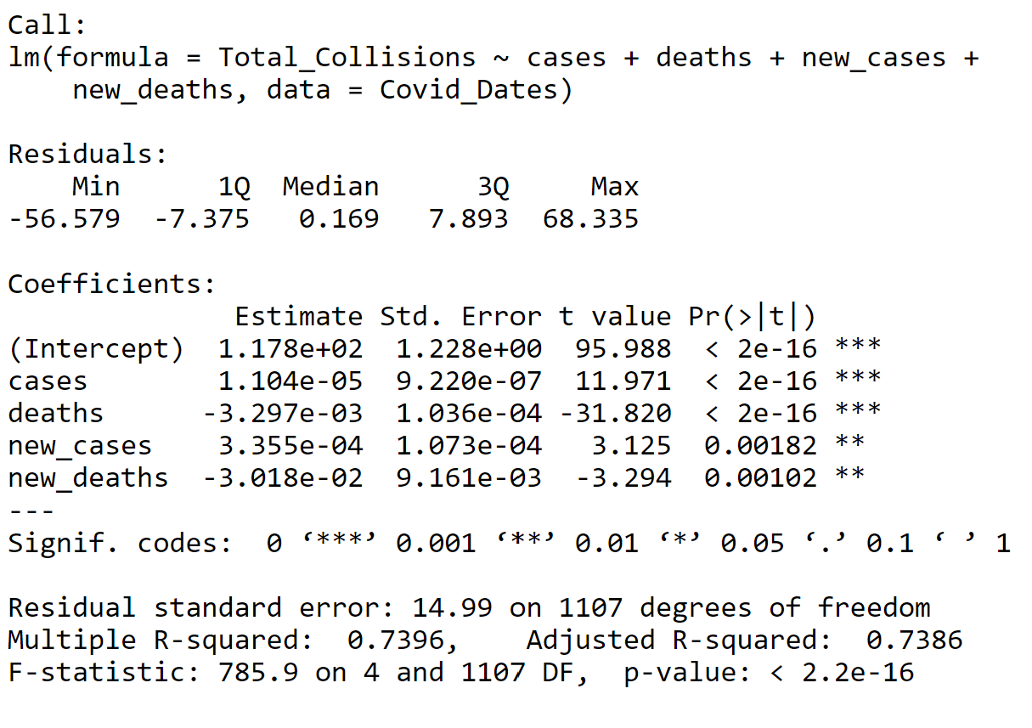
EDA technique: Multiple Linear Regression
Fitting a multiple linear regression model with traffic collisions as the response and cases/deaths and new cases/deaths as the predictors
All variables had significant relationships (p-value < 0.05) , but cases and deaths had more significant relationships
Model had a very good multiple r squared of 0.74

Slide 13
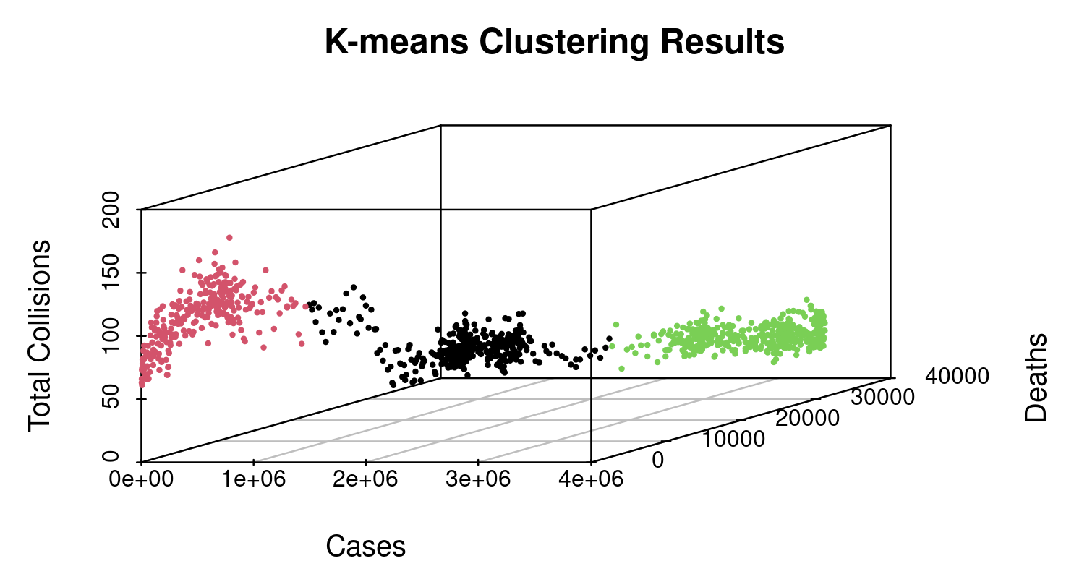
EDA Technique: Kmeans Clustering
Results of Kmeans clustering showed 3 distinct groups
These are likely three different stages of traffic collisions in relation to the pandemic like what could be seen on the traffic collisions vs cases scatterplot

Slide 14

Original models
Linear Regression
Poisson Regression
Principal Component Analysis

Slide 15
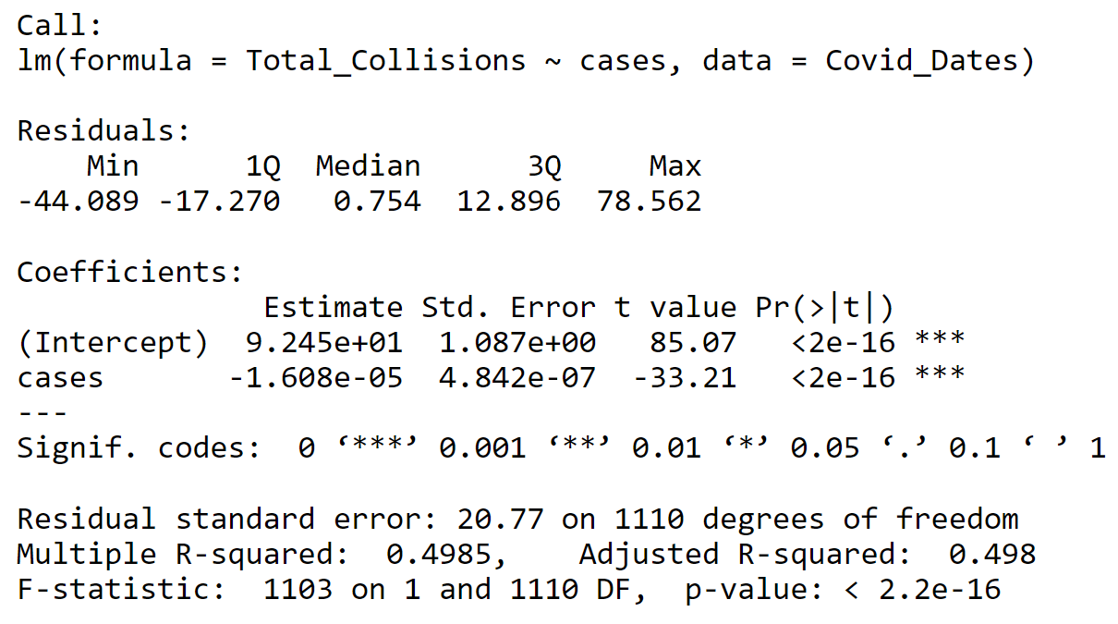
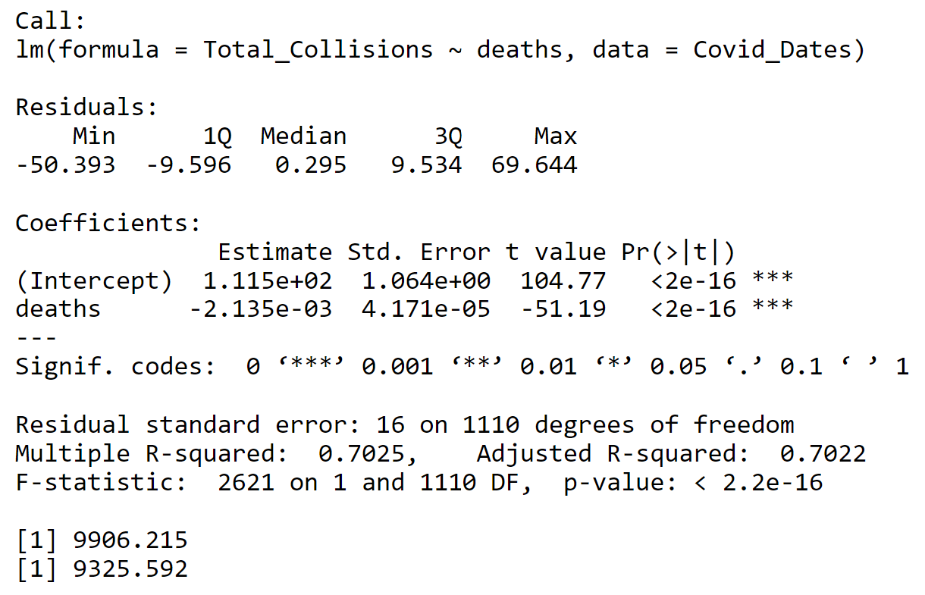
Linear Regression
Negative coefficients: an increase in cases/deaths is associated with a decrease in traffic collisions
Significant models with p-values < 0.05
Deaths model was better fitting with lower AIC (9325 <9906) value and higher multiple R-squared (0.7025 > 0.4985)

Slide 16
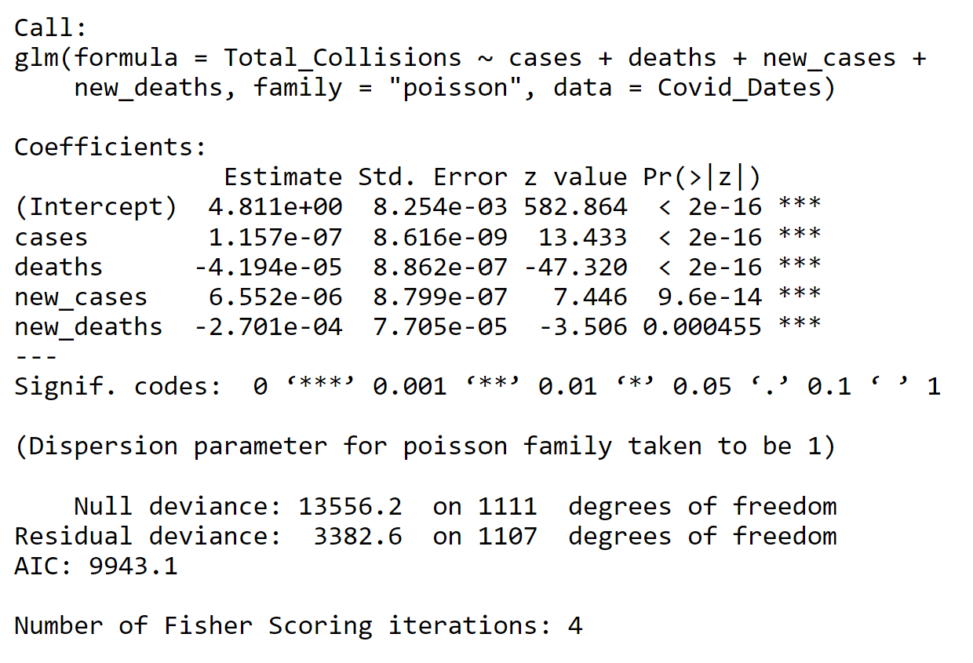
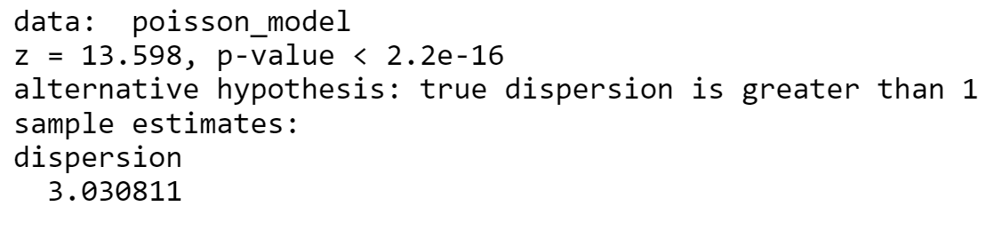
Poisson Regression
Significant relationships between all variables and traffic collisions
AIC score of 9943
High overdispersion score

Slide 17
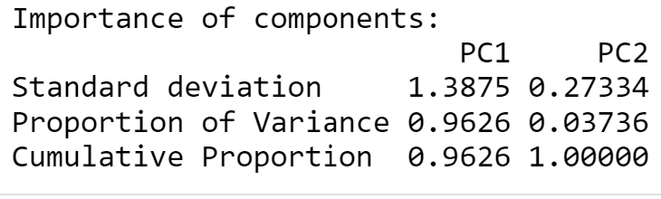
Principal Component Analysis
PC1 accounted for well over 96% if the variance
Good to perform regression on this principle component

Slide 18

Final models
Linear/Polynomial Regression
Negative Binomial Regression
Principal Component Analysis and Regression

Slide 19
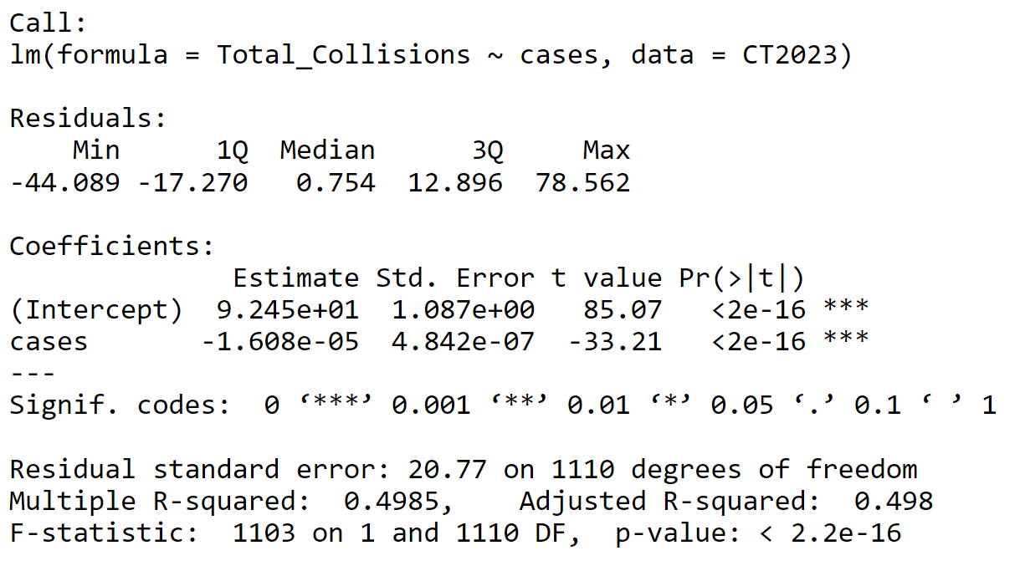
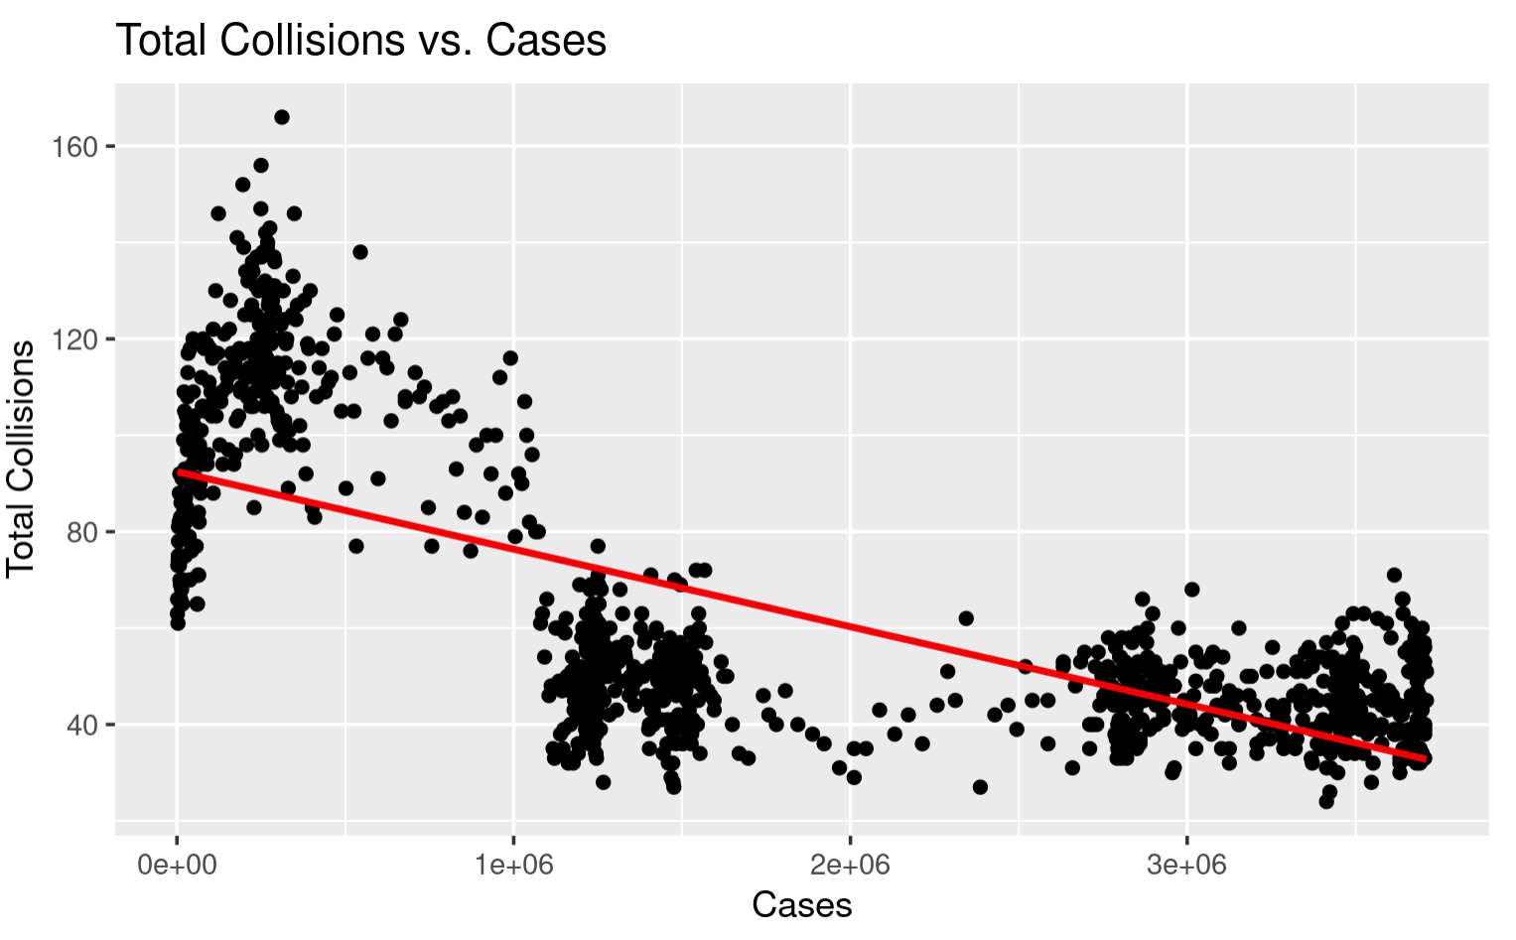
Linear Regression (collisions and cases)
Low p-value: < 0.05
Multiple R-squared: 0.4985
Significant relationship but not a very well-fitting model
Negative coefficient tells me that for each unit cases increase traffic collisions decrease

Slide 20
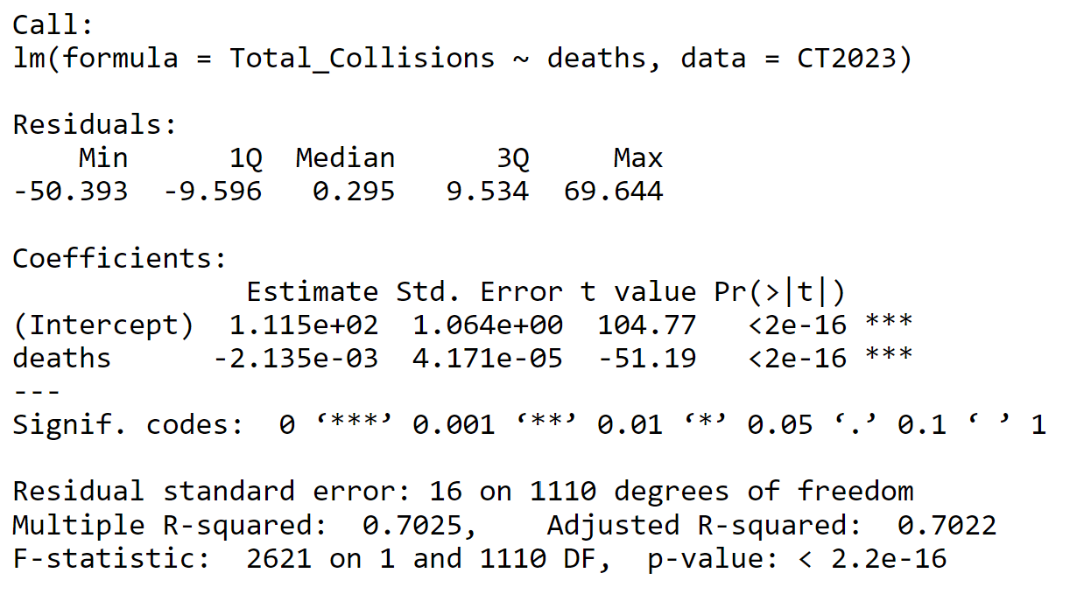
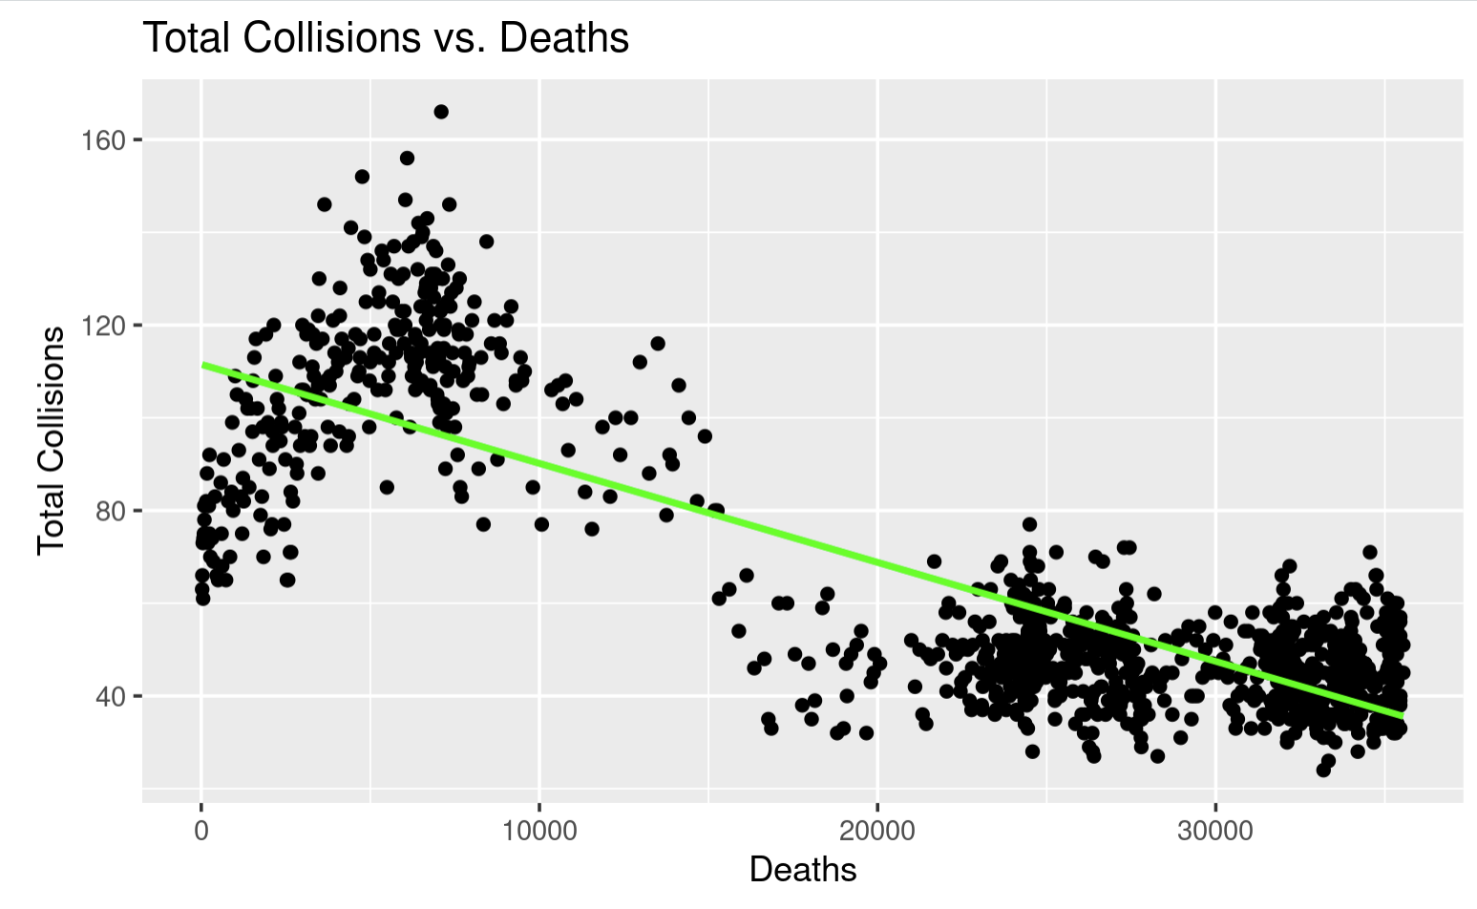
Linear Regression (collisions and deaths)
Significant model: p-value < 0.05
High R-Squared value: 0.7025
Negative coefficient tells me that for each unit deaths increase traffic collisions decrease
Significantly higher R-squared than cases model

Slide 21
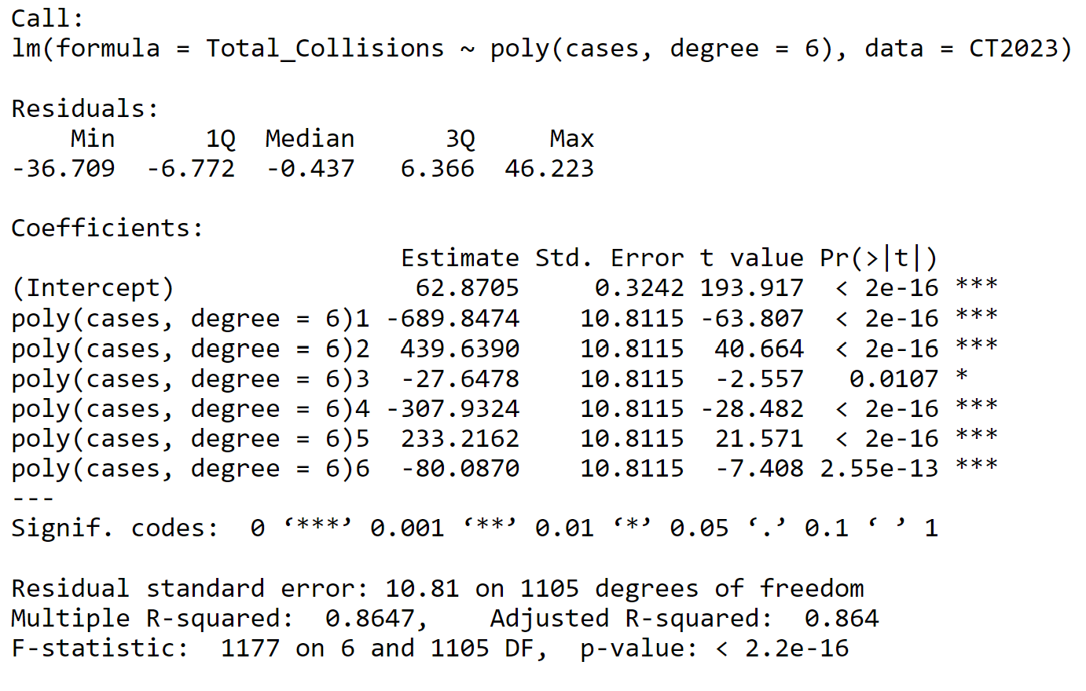
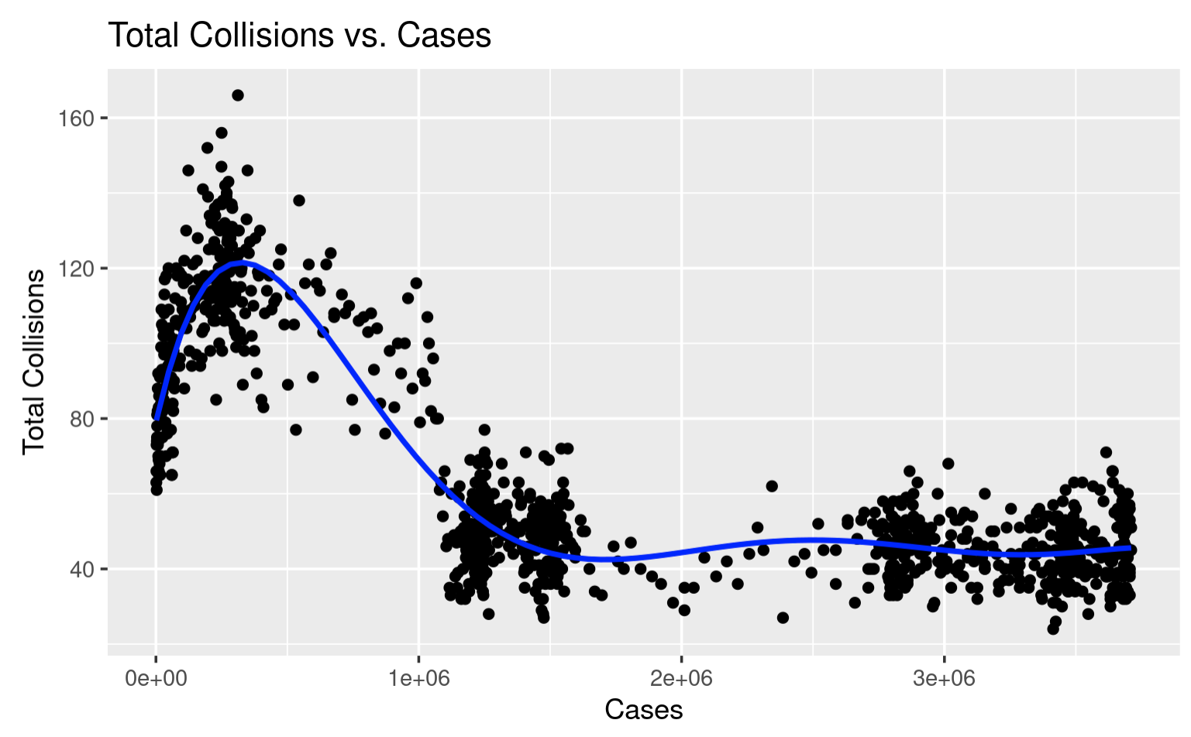
Polynomial Regression (cases and collisions model)
6 Degree polynomial function fit very well, any additional degree polynomials did not improve model by significant amount
Very good multiple R-squared: 0.8647
Regression line fits much better

Slide 22
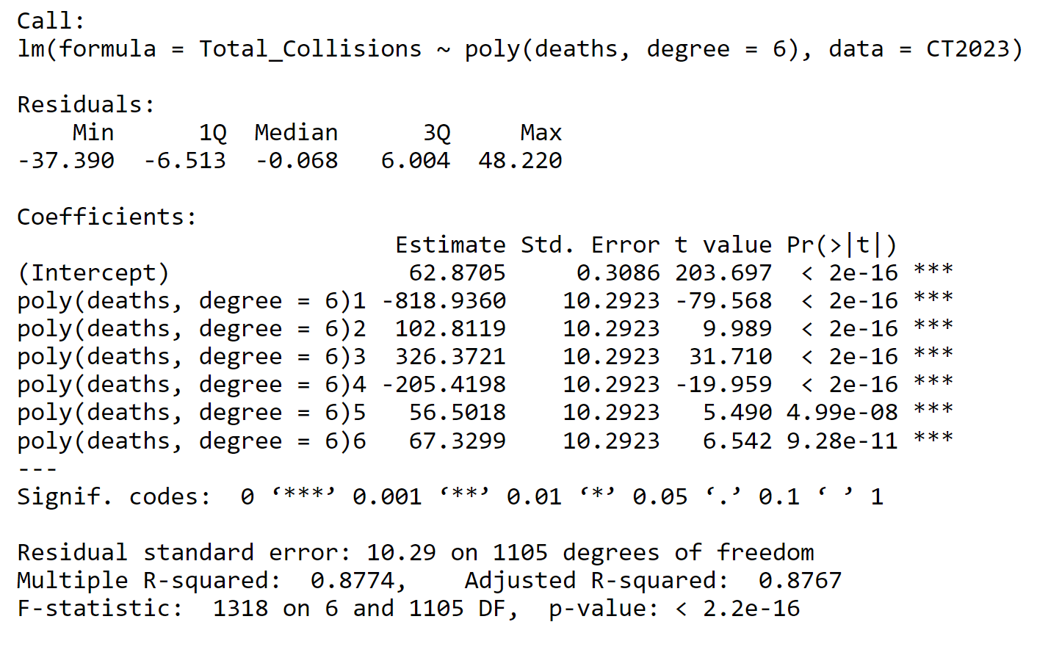
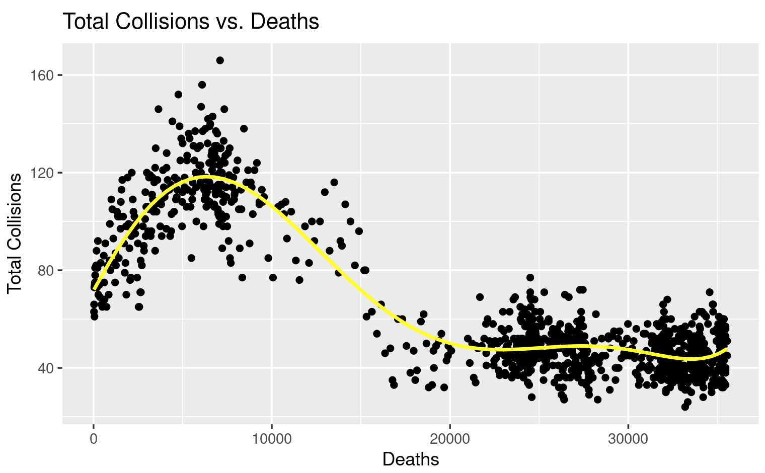
Polynomial Regression (deaths and collisions model)
Just like other polynomial model 6 Degree polynomial function fit very well to deaths vs collisions model
Significant models: low p-value
Very good multiple R-squared: 0.8774
Overall best fitting models so far

Slide 23
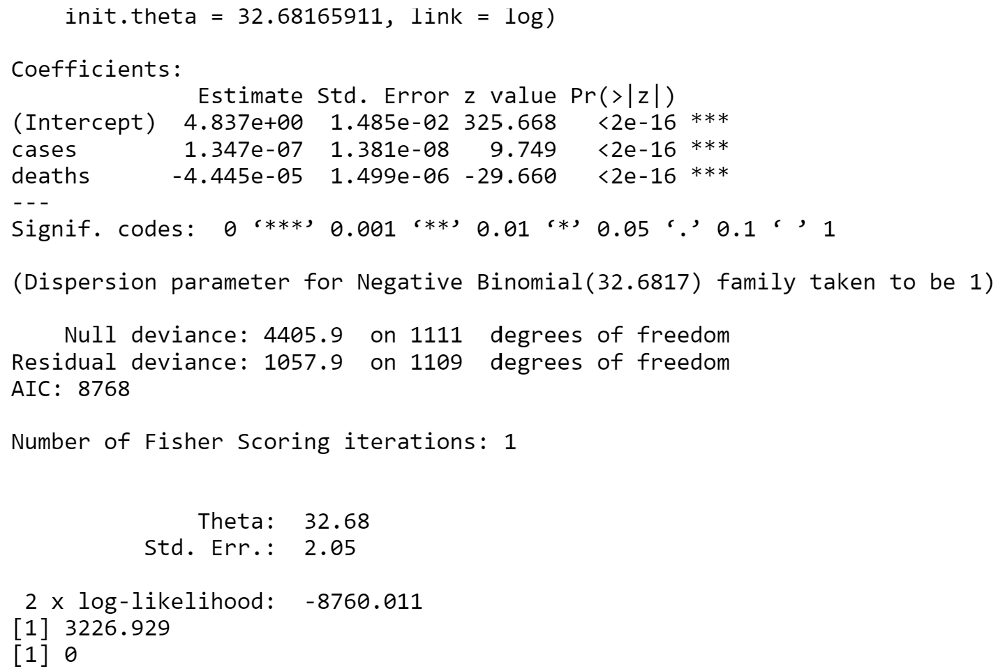
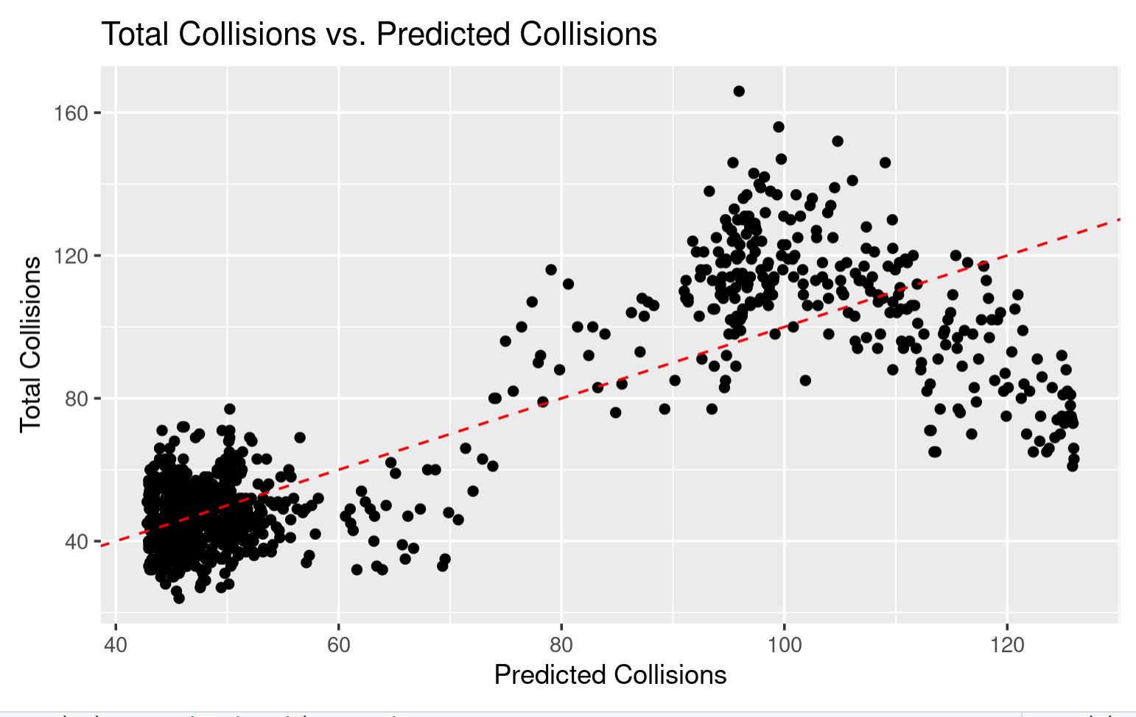
Negative Binomial Regression
Shows significant relationship between collisions and cases/deaths
Far lower AIC value than poisson model (8768 < 9943)
Overall, a much better fitting model than poisson model but not nearly as accurate as polynomial models
Only model to show a positive relationship between cases and collisions

Slide 24
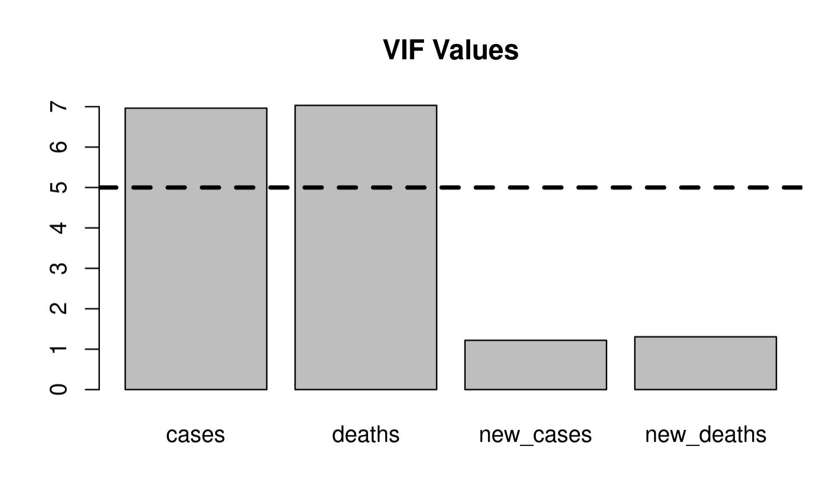
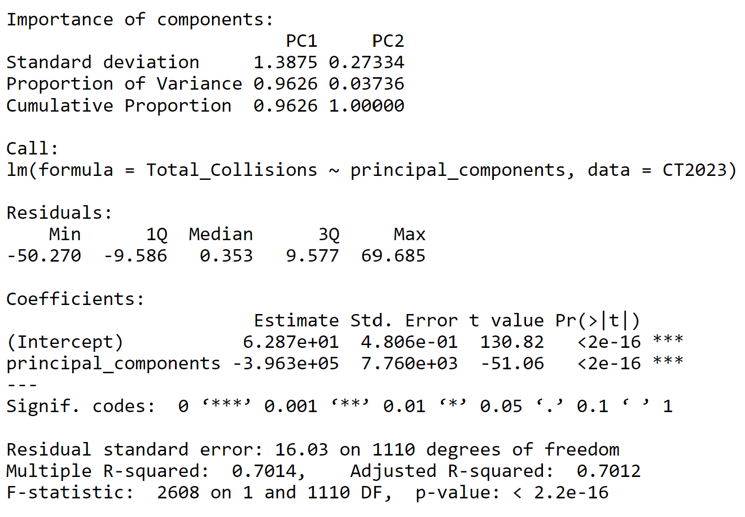
Principle Component Analysis and Regression
VIF values showed potential multicollinearity issues with the data
PC1 Explains around 96% of the variance
Regression model fit to principal component 1
Statistically significant
Multiple R-Squared of 0.7014

Slide 25
Conclusions
Is there a correlation between the number of covid cases/deaths and the number of traffic collisions in Los Angeles California?
Yes, there is a strong correlation between covid cases/deaths and traffic collisions
What is the relationship between these variables and what can we learn from it?
The results from the 4 different regression models all showed a strong negative relationship between covid cases/deaths and traffic collisions. This strong relationship indicates that the pandemic was associated with a large decrease in traffic collisions that has been maintained to this day

Slide 26
Conclusions (cont.)
The best fitting model was the polynomial model
Correlation =/= causation
This does not mean that the pandemic caused the decrease in traffic collisions
This decrease in traffic collisions was likely do to a combination of different factors
At some point during the pandemic, the number of traffic collisions in Los Angeles started to decrease and has stayed at a steady lower rate to this day
This may have been due to city policy, an increase in unreported traffic accidents, or better road safety since the beginning of the pandemic

Slide 27
Future Analysis
Los Angeles Traffic policy analysis
Analysis of traffic fatalities

Slide 28

Thank you for listening!

